Slide 1
ITIL Introduction
Linpei Zhang
April, 2006

Slide 2
What’s ITIL?
ITIL (Information Technology Infrastructure Library) is a framework of best practices approaches intended to facilitate the delivery of high quality information technology services.
- Wikipedia

Slide 3
Okay, what exactly is ITIL?
A series of publications
Best Practices for IT Service Management
  Processes
  Guidelines
  Checklists
Worldwide Industry standard
Management Philosophy

Slide 4
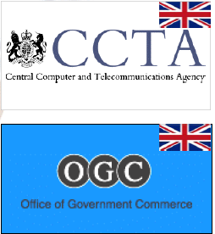
Brief History of ITIL
The Central Computer and Telecommunications Agency of United Kingdom first published elements of ITIL in 1989.
The intention is to improve the management of IT services in UK Central Government
Contributed to by expert IT practitioners around the world.
The UK Office of Government Commerce was established in 2000 and incorporates the CCTA.
The OGC now owns ITIL and is responsible for its maintenance and further development

Slide 5
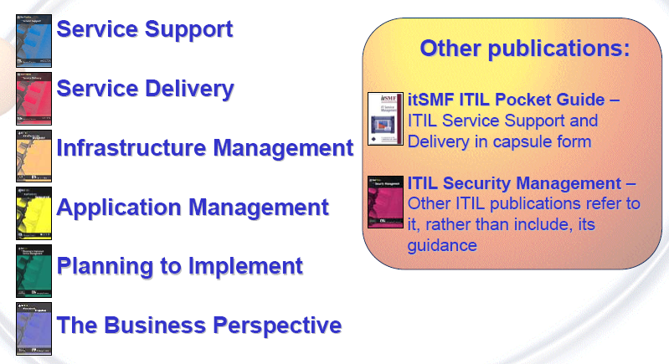
ITIL Publications

Slide 6
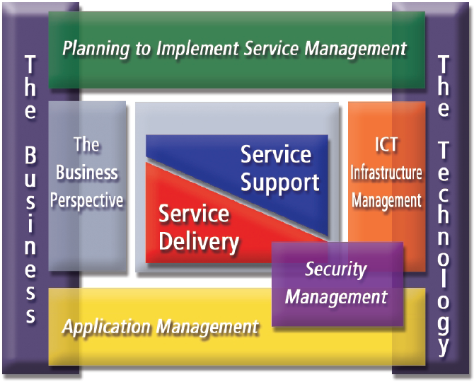
Putting them into context

Slide 7
Frameworks Based on ITIL
HP ITSM Reference Model
  “a model that combines ITIL and industry-standard best practices with years of HP knowledge and experience.”
Microsoft Operations Framework (MOF)
  “Applying the principles of ITIL to the Microsoft technology platform, MOF provides a foundation to help IT organizations meet the challenges”

Slide 8
Other useful frameworks focus on IT efficiency
COBIT (Control Objectives for Information and Related Technologies)
CMM (Capability Maturity Model)
Six Sigma
Balanced Scorecard

Slide 9
International Industry Standards
BS15000
  Published by BSI (British Standards Institution) in 2000 as national standard for UK
ISO20000
  Published by ISO (International Organization for Standardization) on 12/15/2005
  The first International standard for IT Service Management. It’s based on and has superseded BS15000.
Both standards are based heavily upon ITIL

Slide 10
ITIL Philosophy
Service
Quality
Process
Measurement
Cost
Proactive

Slide 11
ITIL Philosophy One - Service
IT Service Management (ITSM) means managing IT as a service business.
Deploy and manage resources to a discrete set of defined services
Thinking ourselves as Service Providers

Slide 12
Behave like Service Providers
Align IT services to the customer and business needs. Find out what the customer needs and make those services available
Partner with the customer to create new ways of doing business. Create new competitive advantages.
Increase the quality of the existing services by organizing around services and working to make those service efficient

Slide 13
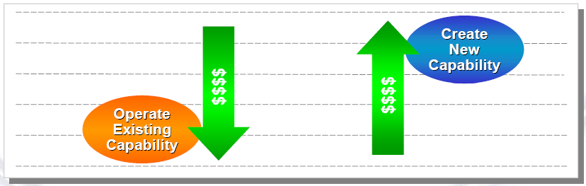
Expected Results
Alignment – Better match IT capability and costs to business needs
Efficiency – Extend existing resources
Reliability – Ensure consistent performance
Agility – Response to business and technology-driven changes

Slide 14
Continuously Improve Service Quality
Where are we now?
Current process & procedures
Current challenges & problems
Where do we want
to be?
What are the priorities?
How do we bridge the gap?
How do we keep the
momentum going
How do we get where
we want to be?
Informed planning
Experienced execution
Are we improving?
Did we get to where we wanted to be?
Strict control
Status communication

Slide 15
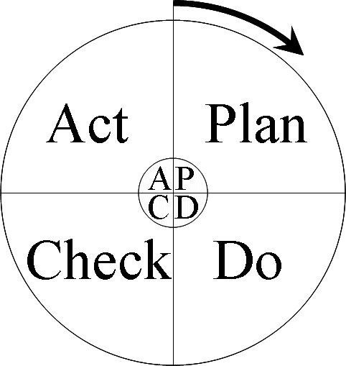
How to get there - Quality Improvement Model
Deming Circle (PDCA)
Plan: Plan ahead for change. Analyze and predict the results.
Do: Execute the plan, taking small steps in controlled circumstances.
Check: Study the results
Act: Take action to standardize or improve the process

Slide 16
Why “Best Effort” is not good enough?
“Best Effort”, “Some Progress”, “Improved Performance”… are not measurable.
“Performance is improved 10%”, “Time to Market decreased from 100 days to 50 days”, “Customer Satisfaction Rate improves 23 percents”. Those are good measurements.
All the measurements must be quantitative!

Slide 17
What to measure?
Goal (Where do we want to go? What are we want to achieve?)
CSF – Critical Success Factors: Determinate factors to achieve the goal
KPI - Key Performance Indicators: Compare the CSF with standards, Quantities measurements

Slide 18
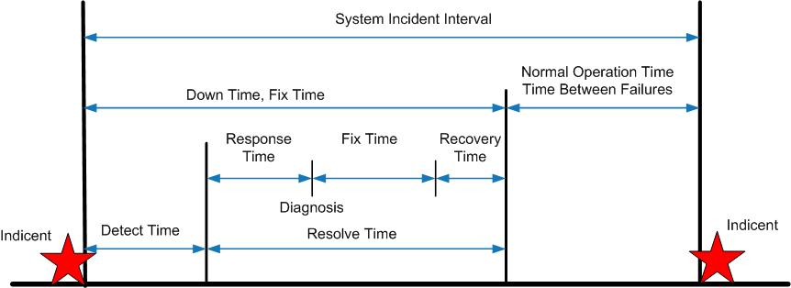
Example: Measure Availability

Slide 19
KPI for Availability
MTTR (Mean Time to Repair): Average Down Time including Detect Time and Resolve Time.
MTBF (Mean Time Between Failures): Average Normal Operation Time
MTBSI (Mean Time Between System Incidents): Average time between two incidents
Availability Ratio: MTBF/MTBSI*100%

Slide 20
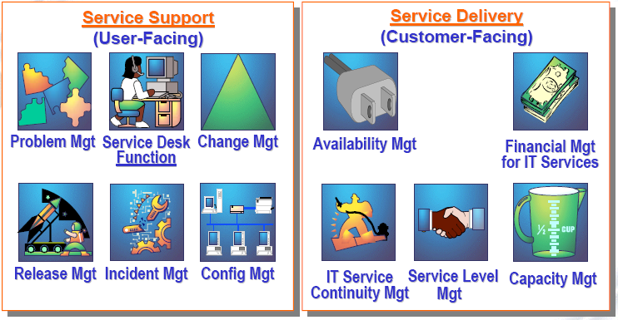
Core ITIL Processes

Slide 21
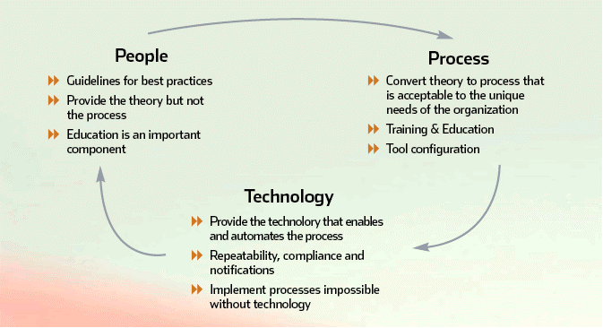
Critical Success Factors

